Slide 1
DW Assignment 2
Markell Wong S10242300

Slide 2
Who will be the Top 6 Constructors in terms of Position for the next race?
Business Problem:

Slide 3
Context behind Business Question
Currently working for a sports beverage company
Company is looking to sponsor a Formula 1 team
Increase brand awareness and grow market share
Management wants to choose a top team
Team Success -> Greater brand recognition and association!
Use a model to predict top teams

Slide 4
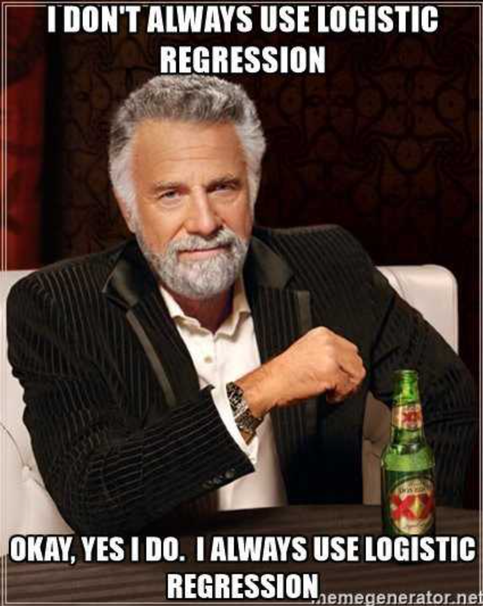
Binary Logistic Regression (Classification)
Machine Learning Model:

Slide 5
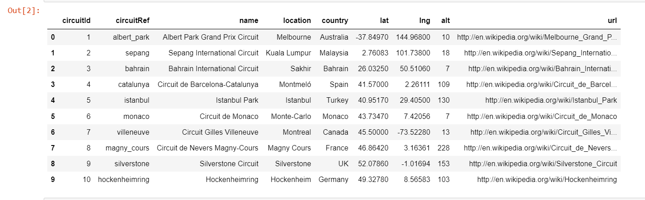
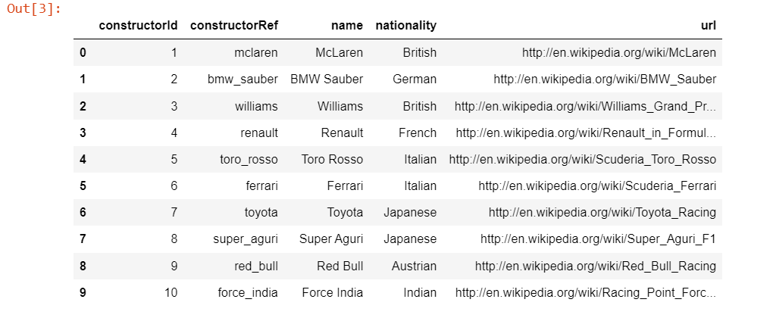
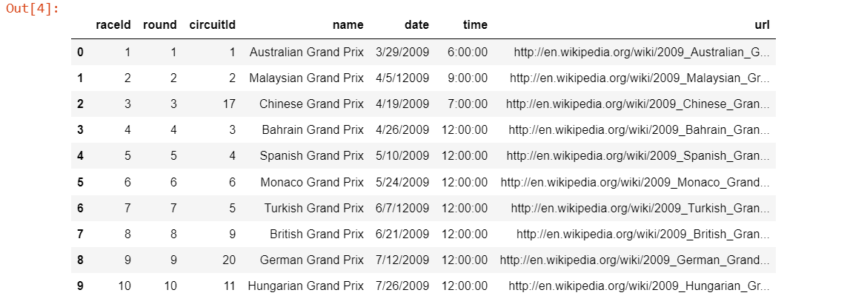
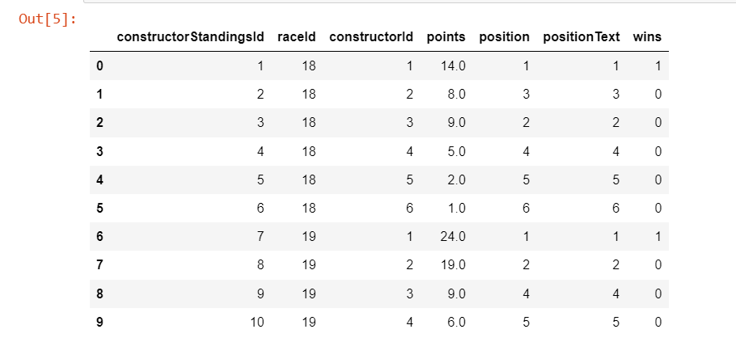
Tables used
circuits_mod
constructors_mod
Final Dataset
races_mod
constructor_standings_mod

Slide 6
Why those Tables?
circuits_mod: circuitRef, location, country, altitude
Different circuit locations and altitude may affect the team performance
constructors_mod: constructorRef, nationality
Details of the constructors
Teams may perform better in home circuits compared to foreign
races_mod: date
Date may play a part in environmental factors
constructor_standing_mod: position, wins
Position is our target variable, wins can help see how successful a team is

Slide 7
Data Wrangling on Multiple Tables
Dropped unusable columns (time, url)
Dropped repeated columns (positionText, lat, lng, name etc)
Created additional features
Using cleaned Date data, created ‘year’, ‘month’, ‘day_of_month’ and ‘day_of_week’
Aggregated average points for each race and added ‘higher_than_mean’ indicator for each row
Summed the number of wins of each constructor

Slide 8
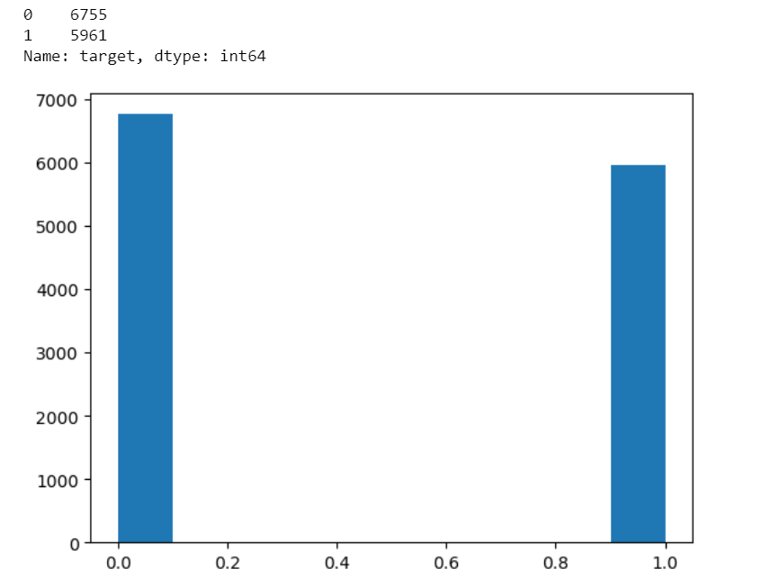
Data Wrangling on Multiple Tables
Created Target Variable
if row['position'] <= 6: return 1
else: return 0
Relatively balanced dataset
Lastly, dropped ID columns (constructorID, raceID etc)
Could be replaced by ref columns
Was not relevant to the model

Slide 9
Data Cleaning and Transformation
Missing Data
Date and Alt features
Small percentage of missing data
Dropped rows for Date features
Median and Random Sampling for ‘alt’, both performed the same
Outlier Removal
points, alt, and sum_of_wins had outliers
Trimming removed 1425 out of 12609 rows
Capping was slightly better than windsorization

Slide 10
Data Cleaning and Transformation
Numerical Transformation
‘alt’ had zero and negative values
Yeo-Johnson and Power transformer
Power gave null values even with different exponential values
Categorical Encoding
Grouped rare categories for categories with >40 values
Target Mean performed slightly better than Ordered Ordinal

Slide 11
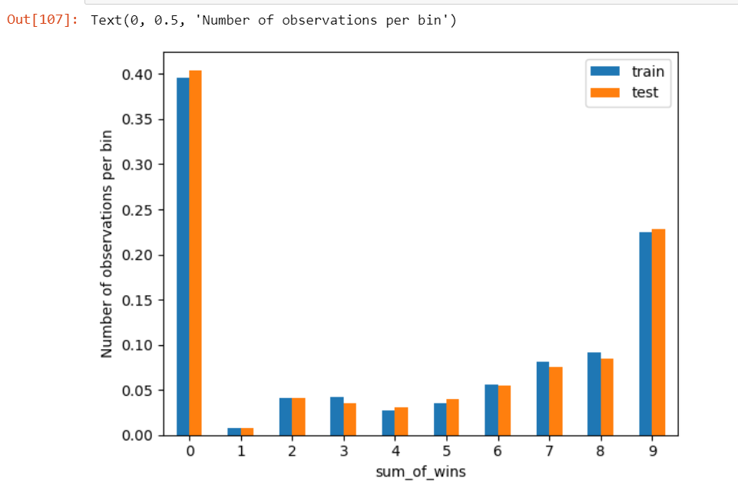
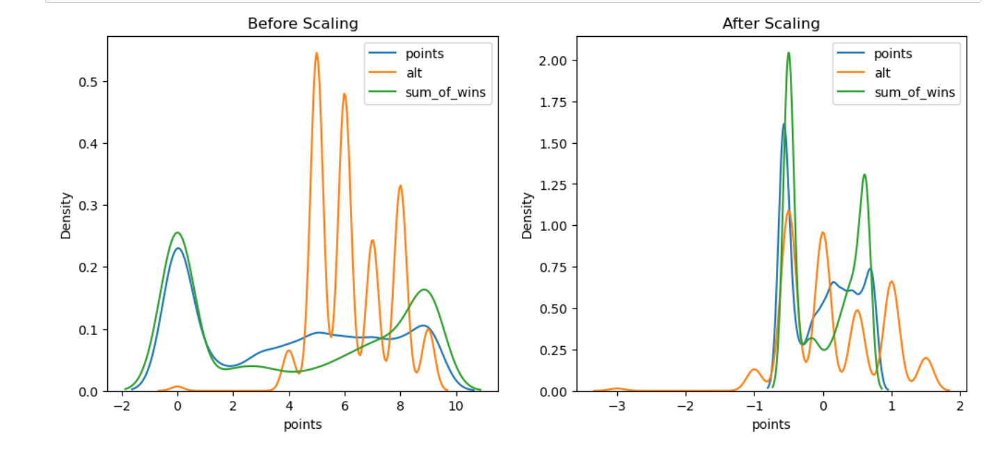
Data Cleaning and Transformation
Binning/Discretization
Equal Frequency, Discretization plus Encoding, Equal Width Frequency
Equal Width performed the best out of the 3
Feature Scaling
Standardization, Min Max, Robust Scaling
Robust seems to be the best of the 3

Slide 12
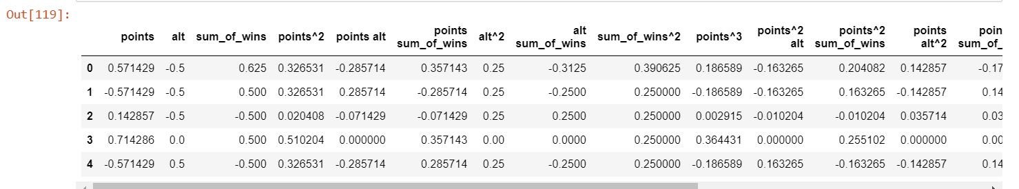
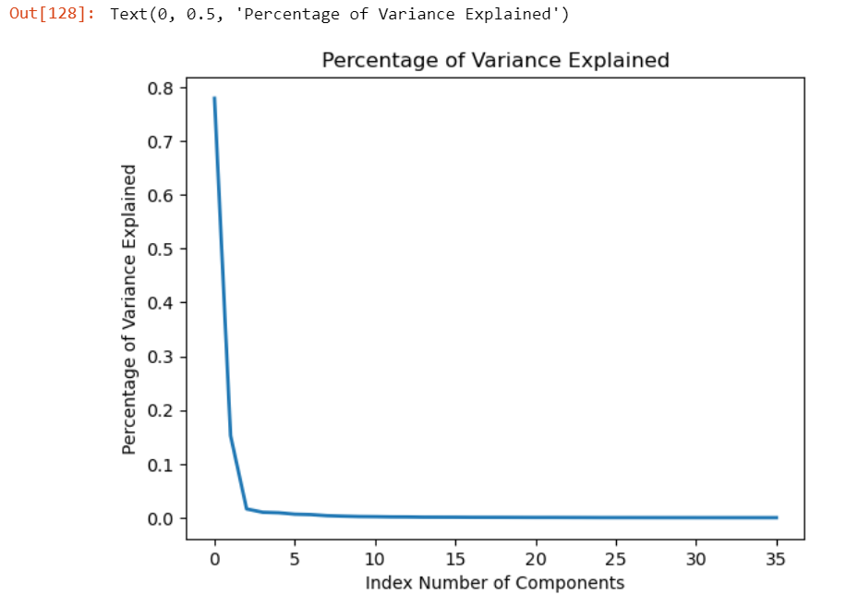
Feature Engineering
Polynomial Expansion
Feature Expansion on ‘points’, ‘alt’ and ‘sum_of_wins’
Improved model performance
Principal Component Analysis
First 5 components made up 95% of the variance
Reducing components seems to impact model performance negatively

Slide 13
Machine Learning Model
Final Train Dataset: 8826 rows, 36 columns
Naïve Baseline Model for Classification
The Naive Baseline Model's accuracy on train data is 52.83%.
The Naive Baseline Model's accuracy on test data is 54.06%.
LogReg model
The LogReg Model's accuracy on train data is 91.30%.
The LogReg Model's accuracy on test data is 91.25%.

Slide 14
Possible Further Improvements
Using additional datasets
Weather data, Car Models, Team Staff
Comparing other Machine Learning models
Probit regression, Decision Trees etc

